Slide 1
Statistics for Linguistics
2024-01-31
Adam J.R. Tallman

Slide 2
From last lecture
Conditional inference trees
Random forests
Introduction to cluster analysis

Slide 3
For this lecture
Hierarchical cluster analysis

Slide 4
Clustering

Slide 5
Clustering analysis
Clustering analysis falls under exploratory data analysis.
There is a quite a bit of literature on using validation techniques that have a sort of confirmatory / inferential goal – its basically a madhouse.
Clustering analysis is a type of machine learning.
When people talk about “algorithms” being used to market products, they are basically talking about some type of clustering analysis.

Slide 6
Clustering analysis
Why isn’t clustering inference?
There is no distinction between dependent and independent variable.
There’s no causal structure in the model
You just have a back of variables and you are using algorithms to classify them into groups.

Slide 7
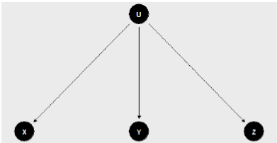
Clustering conceptualized causally
U is an unmeasured variable (assume its a factor)
Let us say that U is responsible for the patterns we find in X, Y and Z.
Can we figure out the value of U?

Slide 8
Clustering analysis
You can use various algorithms to group data points into groups according to their overall closeness with respect to a set of variables considered.
But there are a lot of different clustering algorithms
Why?

Slide 9
Problems with clustering
Cluster has no meaning: There “is not a standard or even useful definition of the term “cluster”, and many have argued that it is either too late or irrelevant to create one”
(Aldenderfer & Blashfield 1984: 33)
Clustering tendency problem: “the problem of deciding whether data exhibit a predisposition to cluster into natural groups without identifying the groups themselves. Clustering algorithms will create clusters whether the data are naturally clustered or purely random”
(Jain & Dubes 1988: 201)

Slide 10
Cluster has no definition
Clusters are calculated based on some measurement of dissimilarity between data points.
Representation of some definition of intercluster dissimilatory; (a) Group average; (b) Nearest neighbor; (c) Further neighbor
from Kaufman 1980: 47

Slide 11
Cluster has no definition
Types of clusters
(a) Ball shapes
(b) elongated
(c) compact but not well seperated

Slide 12
Clustering algorithms
As EDA, clustering is well-known to be a useful tool, but as CDA

Slide 13
Basic concepts
Distance measurement
Distance matrix
Clustering algorithm
Cluster
Clustering tendency problem
Validation method

Slide 14
Types of clustering
k-means clustering
k-medoids clustering
fuzzy clustering
divisive hierarchical clustering
agglomerative hierarchical clustering
...

Slide 15
Types of clustering
k-means clustering
k-medoids clustering
fuzzy clustering
divisive hierarchical clustering
agglomerative hierarchical clustering
...

Slide 16
Hierarchical clustering
Partition
Height of the partition
Euclidean, manhattan and gower distance
Cophenetic correlation
Simulated null distribution

Slide 17
A simulated example

Slide 18
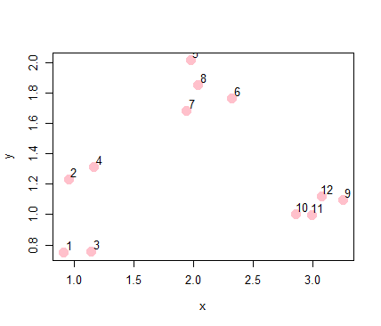
Simulated data
x <- rnorm(12, rep(1:3, each = 4), 0.2)
y <- rnorm(12, rep(c(1, 2, 1), each = 4), 0.2)
plot(x, y, col = "pink", pch = 19, cex = 2)
text(x + 0.05, y + 0.05, labels = as.character(1:12))

Slide 19
Distance measures and distance matrix
There are different ways of measuring distance.
A distance matrix is a matrix that gives you the distance from each of the data points according to the variables you have.
dataFrame <- data.frame(x=x, y=y)
dist(dataFrame)

Slide 20
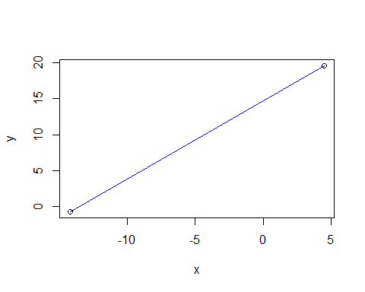
Euclidean distance

Slide 21
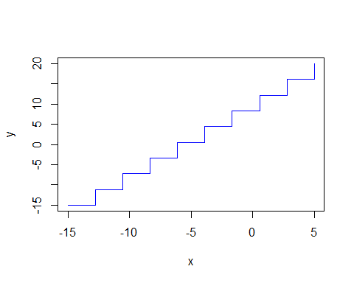
Manhattan distance

Slide 22
Gower distance
This is used for when you have mixed data (or just categorical data).

Slide 23
Distance matrix
set.seed(4321) x <- rnorm(12, rep(1:3, each = 4), 0.2) y <- rnorm(12, rep(c(1, 2, 1), each = 4), 0.2) dataFrame <- data.frame(x=x, y=y) dist(dataFrame, method="euclidean")

Slide 24
## 1 2 3 4 5 6 7 ## 2 0.4818060 ## 3 0.2290071 0.5083847 ## 4 0.6210186 0.2300065 0.5595680 ## 5 1.6516473 1.2874484 1.5084603 1.0675884 ## 6 1.7363507 1.4683435 1.5515341 1.2383578 0.4279533 ## 7 1.3877613 1.0850453 1.2223180 0.8553386 0.3340584 0.3901532 ## 8 1.5749957 1.2500236 1.4145687 1.0225625 0.1765242 0.2953299 0.1949666 ## 9 2.3594401 2.2966216 2.1320837 2.0912494 1.5701360 1.1421832 1.4327423 ## 10 1.9578445 1.9146662 1.7299970 1.7171607 1.3448566 0.9336432 1.1423308 ## 11 2.0869817 2.0442189 1.8589258 1.8455955 1.4345148 1.0147559 1.2498504 ## 12 2.1859159 2.1164159 1.9592779 1.9106631 1.4145273 0.9877883 1.2612721 ## 8 9 10 11 ## 2 ## 3 ## 4 ## 5 ## 6 ## 7 ## 8 ## 9 1.4247104 ## 10 1.1798333 0.4037896 ## 11 1.2743264 0.2795230 0.1302977 ## 12 1.2632629 0.1806167 0.2437852 0.1458997

Slide 25
Clustering
Once you have a distance matrix you can use your cluster method.
The distance matrix is then used to group data points into groups.
I’ll exemplify this with the agglomerative hierarchical cluster method.

Slide 26
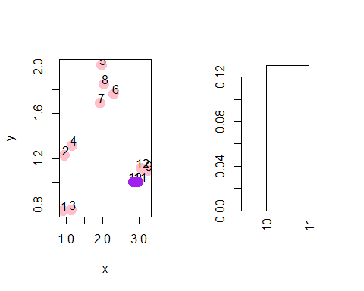
Hierarchical clustering
First the method takes the closest two points and turns them into one point – “clusters” them
ind <- which(rdistxy == min(rdistxy), arr.ind = TRUE) ind

Slide 27
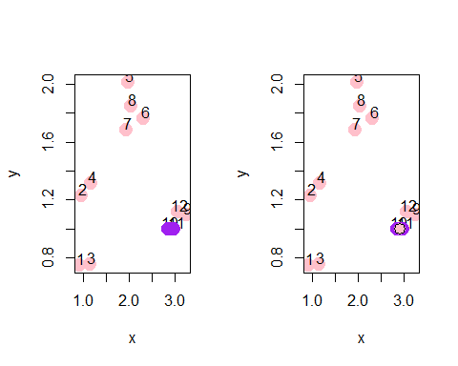
Hierarchical clustering
On the next run of the algorithm the cluster is now treated as a single data point.

Slide 28
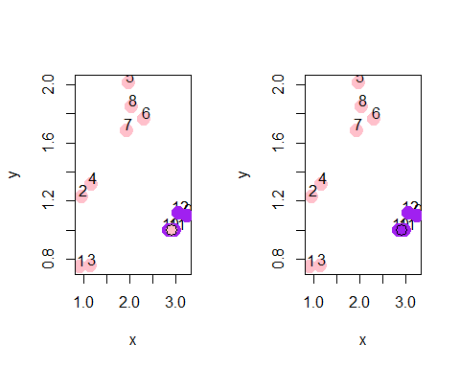
Hierarchical clustering

Slide 29
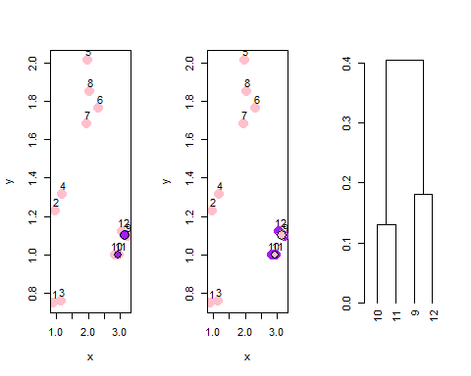
Hierarchical clustering

Slide 30
Hierarchical clustering
It keeps going until everything is clustered into groups.
hcluster <- dist(dataFrame) clusters <- hclust(hcluster)
par(mfrow = c(1, 1)) plot(dendro)

Slide 31
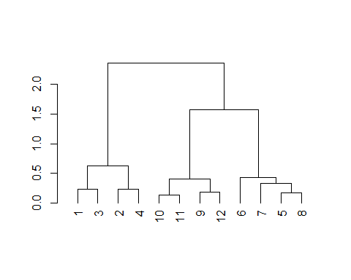
Hierarchical clustering

Slide 32
Cophenetic correlation
Correlation between cluster distance and matrix distance
Shows you how well things cluster overall vis-a-vis your clustering algorithm + distance measurement
plot(hcluster, cophenetic(clusters))abline(lm(hcluster~cophenetic(clusters)))

Slide 33
A real example
Clause-linkage in cross-linguistic perspective
Is there a general distinction between coordinate and subordinate clauses?

